Slide 1
Preliminary Results
Accounting for Uncertainty with Neural Nets
04.05.2018

Slide 2
Contents
Multi-Objective Program (MOP)
Robust Formulation
Solution Evaluation
Recourse vs No Recourse
Scenario Generation with Distribution

Slide 3
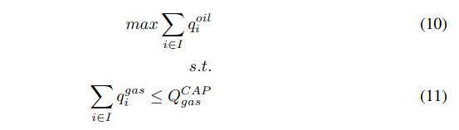
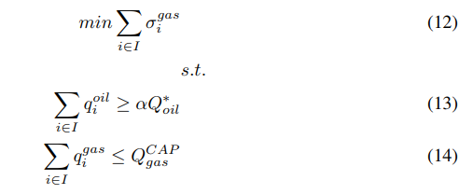
Multi-Objective Program (MOP)
First find optimal oil production level by solving
Then produce Pareto front by minimizing gas variance while keeping oil production above level α:

Slide 4
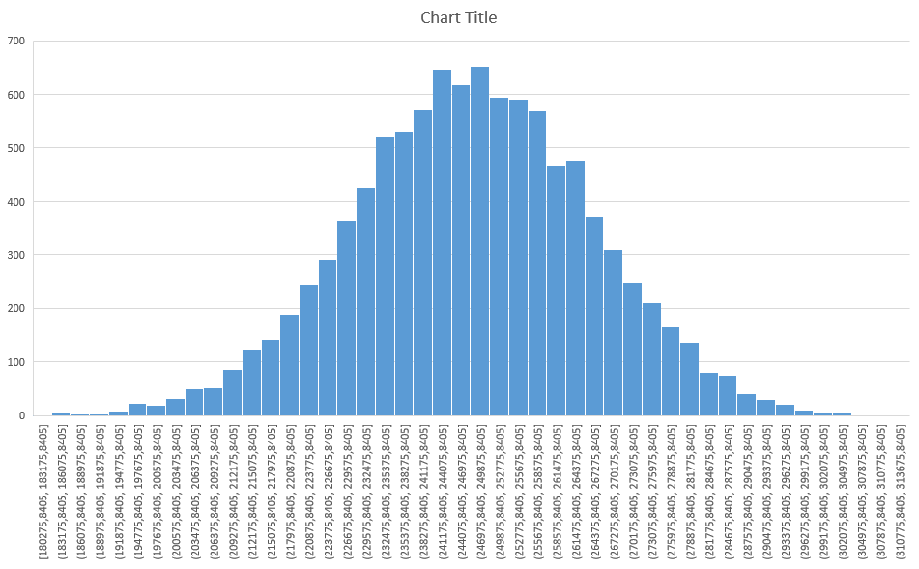

MOP – Pareto Front
Y-axis is «Precision», the difference between maximum variance and variance given α
Use this measure to get desired shape where «right upwards» represents better solutions
Plot on the right: Pareto front for
α ϵ [0.01, 1]

Slide 5
MOP – Discussion Points
How do we treat individual standard deviations/variance of 7 wells in a single optimization problem?
Independent wells mean variance may cancel out on aggregate (with many wells)
Difficult to quantify covariance
May still be reasonable to consider sum as «total uncertainty»?

Slide 6


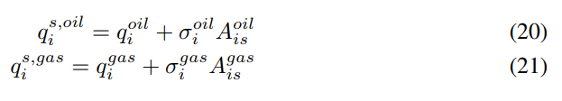

Robust Formulation
Ensure gas capacity constraint holds in all scenarios:
Scenarios generated by drawing variance factor per well per scenario:

Slide 7
Scenario Evaluation
Two ways to evaluate scenarios:
No recourse, infeasibility occurs
Recourse, avoid infeasibility
Generally solve problem for ≤ 100 scenarios and evaluate solution for ≥10 000 scenarios

Slide 8
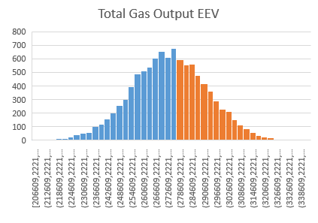
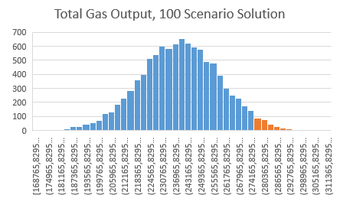
Results, No Recourse
Follow choke values from solution regardless of whether we hit infeasibility
As expected, EEV yields infeasible values in about 49,7% of the scenarios (red bars top histogram)
100 scenarios solution is infeasible in about 3,8% of the scenarios (red bars bottom histogram)
If we record oil output in infeasible scenarios as 0, this evaluation will be very strict w.r.t the EEV solution
EEV: 60,15
Robust: 106,10

Slide 9
Results, Recourse Option
Recourse heuristic:
For each scenario, sequentially turn on well choke settings until we hit the gas capacity constraint
We then stop and record objective solution
Order of wells to turn on decided by their mean gas-oil-ratio (GOR) over all feasible choke settings, where wells with low GOR are turned on first
More realistic evaluation of scenarios

Slide 10
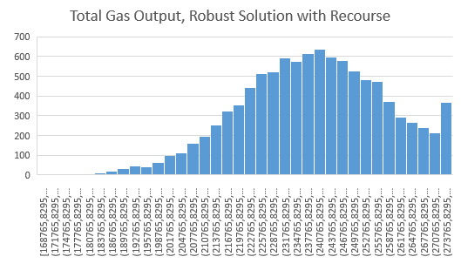
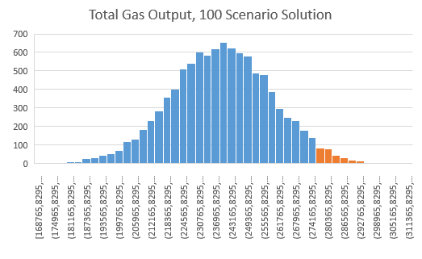
Results, Recourse Option
The robust solution is only infeasible in 3,8% of the scenarios and follows the heuristic in these cases
The robust solution with recourse reaches average oil output of 110,25

Slide 11
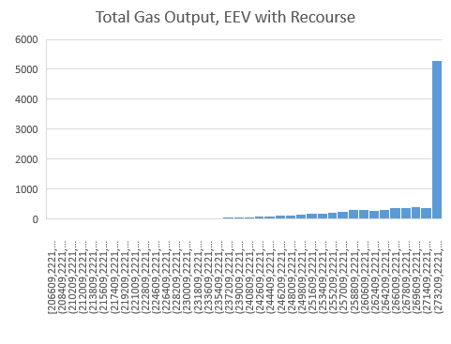
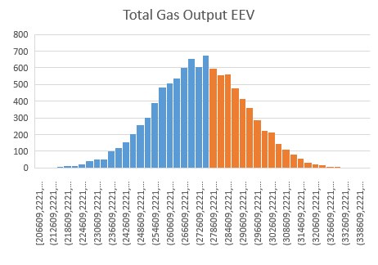

Results, Recourse Option
Since EEV produces a solution that is infeasible in 50% of the scenarios, it is «rewarded» by being allowed to follow the greedy heuristic in these scenarios
EEV with recourse thus reaches an average oil output of 117,22
In 50% of scenarios, EEV is a wait-and-see heuristic

Slide 12
Summary of Numerical Results
Robust, 100 scenarios
No recourse: 106,10
Recourse: 110,25
EEV
No Recourse: 60,15
Recourse: 117,22

Slide 13
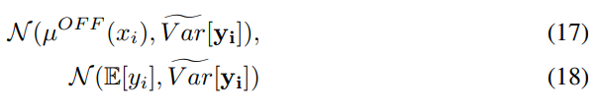
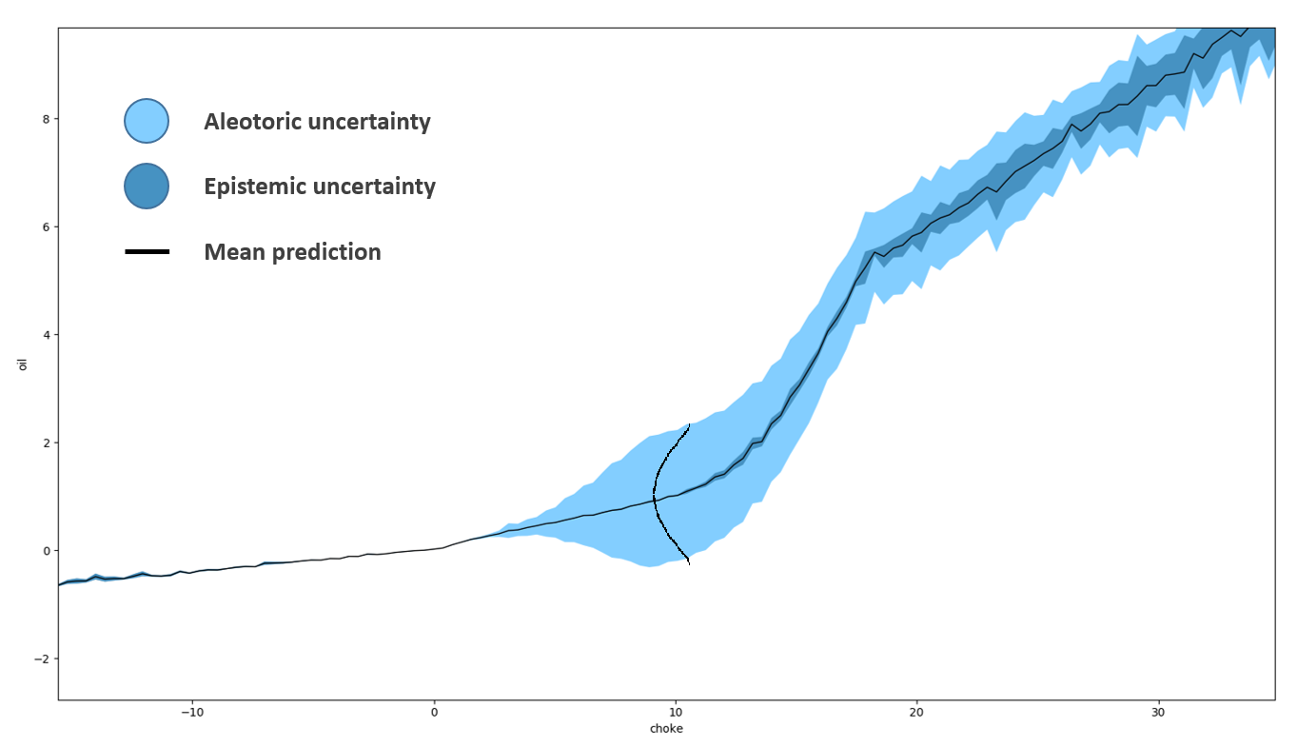
Scenario Generation with Distribution
Create scenarios by sampling from one of the distributions given by the neural network:
Then fit a new neural network to the sampled points
Since variance is «baked into» sample, scenario network is just output predictions without variance
_{Var[yi]}
µ^{OFF}

Slide 14
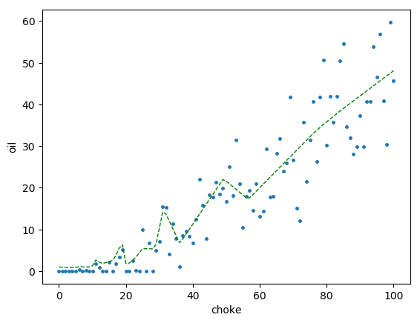
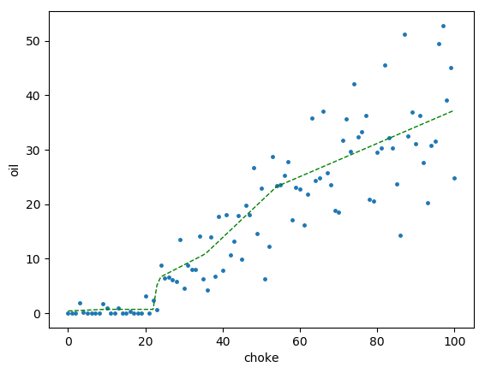
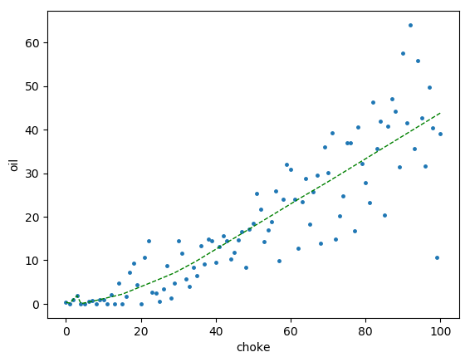
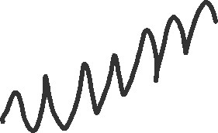
Scenario Generation with Distribution
Examples of 3 sets of points drawn from distribution for same well

Slide 15
Discussion Points
If we do not care about overfitting, we may end up with a zig-zag curve
On the other hand, if the network does not overfit we are in effect back at the mean
A large amount of neurons with many training epochs still struggle to overfit the data. The excessive amount of neurons will slow down optimization models

